Slide 1
Overview of Assessment & 2021 Assessment Roll
Village of Sayward
Maurice Primeau, Deputy Assessor
Vancouver Island Region
March 2, 2021

Slide 2
Topics
    About BC Assessment
    Valuation
    Classification
    Assessment cycle & key dates
    Relationship between assessments & taxes
    2021 Assessment Roll overview
    Collaborating with BC Assessment

Slide 3
Who we are, what we do, & how we do it

Slide 4

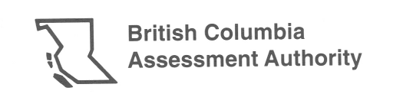

Evolution of BC Assessment
Established in 1974 under the Assessment Authority Act
A provincial Crown corporation, operating independent of taxing function & politics
Provides uniform and fair property assessments to B.C.’s property owners
1975: 879,000 properties assessed
2021: 2.1 million property assessed

Slide 5
Our product
The Assessment Roll
Annual list of property values provides stable, predictable base for real property taxation in B.C.
Identifies ownership, value, classification & exemptions for each property
Represents over 2 million properties with total value of $2 trillion
Provides the base for local governments & taxing authorities to raise approximately $8 billion annually in property taxes for schools & important local services

Slide 6
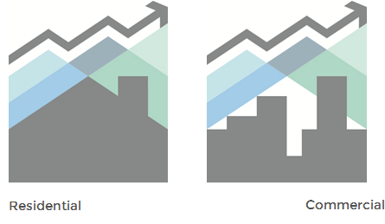
How we value different properties
Market value as of July 1st
  Residential
  Commercial
  Market value is the most probable price which a property should bring in a competitive market under all conditions requisite to a fair sale, the buyer & seller, each acting prudently, knowledgeably & assuming the price is not affected by undue stimulus.
Legislated (regulated values)

Slide 7
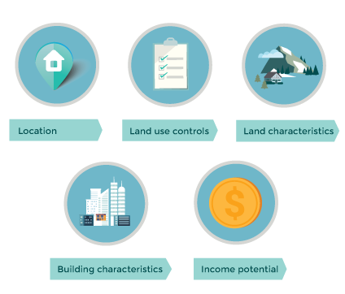
Factors affecting market value

Slide 8
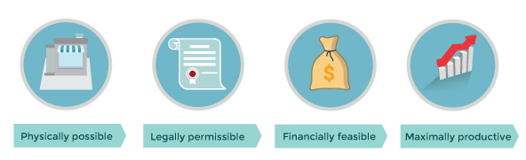
Highest & Best Use (H&BU)
  Foundation of market value is H&BU, which is the reasonable probable use of a property that is:

Slide 9
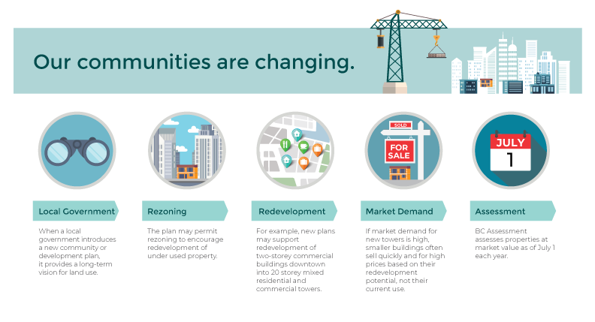
How land use affects market value

Slide 10
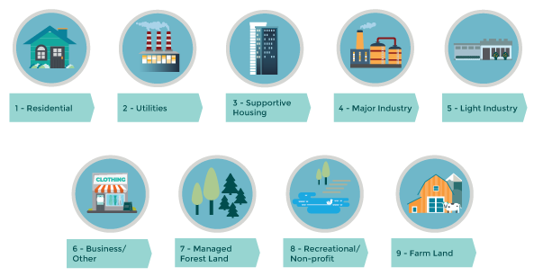
How we classify properties

Slide 11
Assessment annual cycle & key dates
Jan. 1-31
Inquiry period
Jan. 31 = PARP appeal deadline
Feb. 1 – March 31
PARP appeal hearings
Revised Roll production
April 1 - Sept. 30
Assessment projects completed
New construction inspected
April 30 = PAAB appeal deadline
July 1 = Valuation date
Oct. 1 – Dec. 31
Roll production
Oct. 31 = Physical condition & permitted use
Nov. 30 = Ownership reflects LTSA records
Dec. 31 = Assessment notices produced & mailed
Dec. 31 = Liability for taxation

Slide 12
Relationship between assessment & taxation
Assessed Value
Property Tax Rate
Property Taxes Payable
Received January
BC Assessment
Spring
Set by Taxing Authority
Due 1st Business Day July*

Slide 13
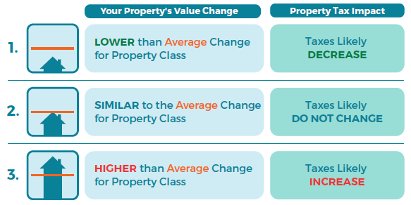
Impact of changes in assessed value on taxes
  “My assessment has gone up 20%, I can't afford for my taxes to go up 20%!”

Slide 14
2021 Assessment Roll overview
British Columbia
Vancouver Island
Village of Sayward

Slide 15



2021 completed roll highlights
British Columbia Assessment Roll
18.6%
1.1%
3.9%
Decrease from 2020
Roll
Increase from 2020
Roll
Increase from 2020
Roll
Total properties
2,114,855
Total value
$2.01 trillion
Total non-market change
$22.06 billion
Notes:
-Total folios assessed in the Province has increased 141% (879,000 to 2,114,855) from 1975 to 2021
-Total assessed value in the Province has increased 4,662% ($42.2 billion to $2.01 trillion) from 1975 to 2021

Slide 16
Province Wide Assessment Change - 2021 Roll
Majority of Residential Properties
Property Type | Range of % Changes in Value (as of July 1, 2020)
Residential Single Family Homes | 0% to +10%
Residential Strata Homes (e.g. condos/townhouses) | 0% to +10%
Notes:
Overall, Vancouver Island’s total assessments increased from about $255 billion in 2020 to $269 billion this year. Over $3.47 billion of the region’s updated assessments is from new construction, subdivisions and rezoning of properties.
BC Assessment’s Vancouver Island region includes all communities located within Greater Victoria, South Island, Central Island, North Island, West Coast, Northern and Southern Gulf Islands and Powell River.

Slide 17
Market Trends – Single Family Residential
Greater Victoria
Single Family Homes by Community | 2020 Typical Assessed Value as of July 1, 2019 | 2021 Typical Assessed Value as of July 1, 2020 | % Change
City of Colwood | $631,000 | $685,000 | +9%
City of Victoria | $820,000 | $868,000 | +6%
District of Central Saanich | $739,000 | $774,000 | +5%
Township of Esquimalt | $702,000 | $758,000 | +8%
District of Saanich | $813,000 | $849,000 | +4%
District of Oak Bay | $1,144,000 | $1,228,000 | +7%
City of Langford | $623,000 | $674,000 | +8%
District of North Saanich | $897,000 | $957,000 | +7%
District of Metchosin | $776,000 | $854,000 | +10%
District of Sooke | $517,000 | $558,000 | +8%
District of Highlands | $811,000 | $854,000 | +5%
Town of View Royal | $746,000 | $789,000 | +6%
Town of Sidney | $691,000 | $729,000 | +6%
Gulf Islands | $547,000 | $585,000 | +7%
Notes:
4-10% change, in step with rest of BC

Slide 18
Market Trends – Single Family Residential
Central Vancouver Island
Single Family Homes by Community | 2020 Typical Assessed Value as of July 1, 2019 | 2021 Typical Assessed Value as of July 1, 2020 | % Change
Town of Ladysmith | $445,000 | $476,000 | +7%
Town of Lake Cowichan | $340,000 | $368,000 | +8%
City of Duncan | $370,000 | $388,000 | +5%
District of N. Cowichan | $459,000 | $489,000 | +7%
District of Lantzville | $608,000 | $640,000 | +5%
City of Nanaimo | $504,000 | $527,000 | +5%
Nanaimo Rural | $461,000 | $502,000 | +9%
Town of Qualicum Beach | $596,000 | $632,000 | +6%
City of Parksville | $488,000 | $505,000 | +3%
District of Tofino | $877,000 | $956,000 | +9%
Town of Ucluelet | $447,000 | $496,000 | +11%
City of Port Alberni | $299,000 | $320,000 | +7%
Town of Ladysmith | $445,000 | $476,000 | +7%
Town of Lake Cowichan | $340,000 | $368,000 | +8%
Notes:
3-11% change, in step with rest of BC

Slide 19
Market Trends – Single Family Residential
Northern Vancouver Island
Single Family Homes by Community | 2020 Typical Assessed Value as of July 1, 2019 | 2021 Typical Assessed Value as of July 1, 2020 | % Change
City of Courtenay | $456,000 | $488,000 | +7%
Town of Comox | $526,000 | $555,000 | +6%
Village of Cumberland | $493,000 | $524,000 | +6%
City of Campbell River | $441,000 | $464,000 | +5%
Campbell River Rural | $402,000 | $421,000 | +5%
District of Port Hardy | $195,000 | $214,000 | +10%
Village of Port Alice | $136,000 | $153,000 | +12%
Town of Port McNeil | $230,000 | $229,000 | 0%
Village of Gold River | $182,000 | $212,000 | +17%
Village of Tahsis | $99,000 | $135,000 | +36%
Village of Alert Bay | $149,000 | $164,000 | +10%
Village of Sayward | $234,000 | $240,000 | +3%
Village of Zeballos | $59,000 | $69,000 | +18%
Notes:
Sayward median SFD values are now at pace with Port hardy, Port McNeil, Gold River with Tahsis, Alert Bay and Zeballos on the rise

Slide 20

Sayward 2021 Assessment Roll - At a Glance
Single Family Dwellings make up 88% of Class 01 ($34.15m)
Strata Residential makes up 5.5% of Class 01 ($2.13m)
Total Class 01 ($38.89m) – 90% of total Sayward Assessment Roll
Only two 2021 Assessment Roll residential appeals to the Property Assessment review Panel (PARP)
No outstanding Property Assessment Appeal Board (PAAB) for previous years

Slide 21

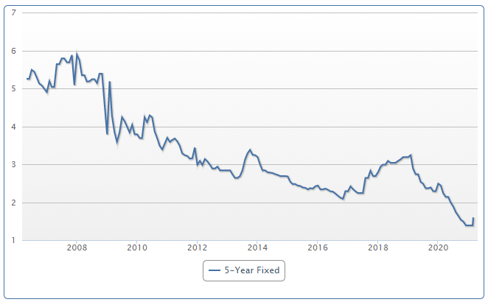
2020 – An interesting year for us all…
Residential – Class 01
March 2020 – CMHC predicted a declining residential market due to COVID
2020 Q2-Q4 – Residential sales volumes up 50% over 2019, sales higher than list, multiple bids
Home values across Vancouver Island have appreciated this year due to strong demand combined with limited inventory for sale
Vancouver Island 2021 Residential Assessments up typical 5% to 10%; comparable to the rest of BC

Slide 22

2020 – An interesting year for us all…
Business & Other – Class 06
Assessment values are largely driven by market demand and income activity. Depending on economic factors, sectors that are recovering quickly will see a low impact in assessed values compared to sectors that need longer to recover.
Commercial property owners can anticipate a mix in value changes based on trends in the real estate market as of July 1, 2020.
2021 commercial assessments will be varied with increases and decreases depending upon the specific sector.
Changes in property assessments really depend on the property type and location.
Notes:
more noticeable than others

Slide 23
Collaborating with BC Assessment

Slide 24

Collaborating to achieve our mandates
  By sharing information & working together BC Assessment & Local Governments can:
    Ensure fair & equitable property assessments
    Maintain a stable & predictable assessment roll
    Optimize property tax revenue levied & collected by taxing authorities
    Increase citizen awareness of property assessment & taxation

Slide 25
Taxing Authority information sharing
  The following information can affect assessed value, classification, & taxability of properties:
Information | Method
Building permits | Standard Permit Program Citrix ShareFile
Building plans Land use control amendments Development applications & approvals Extensions of service infrastructure Permissive & revitalization tax exemptions Occupiers/lessees of civic properties Situs (civic address) assignments | Citrix ShareFile
Mailing address changes | e-form Citrix ShareFile

Slide 26
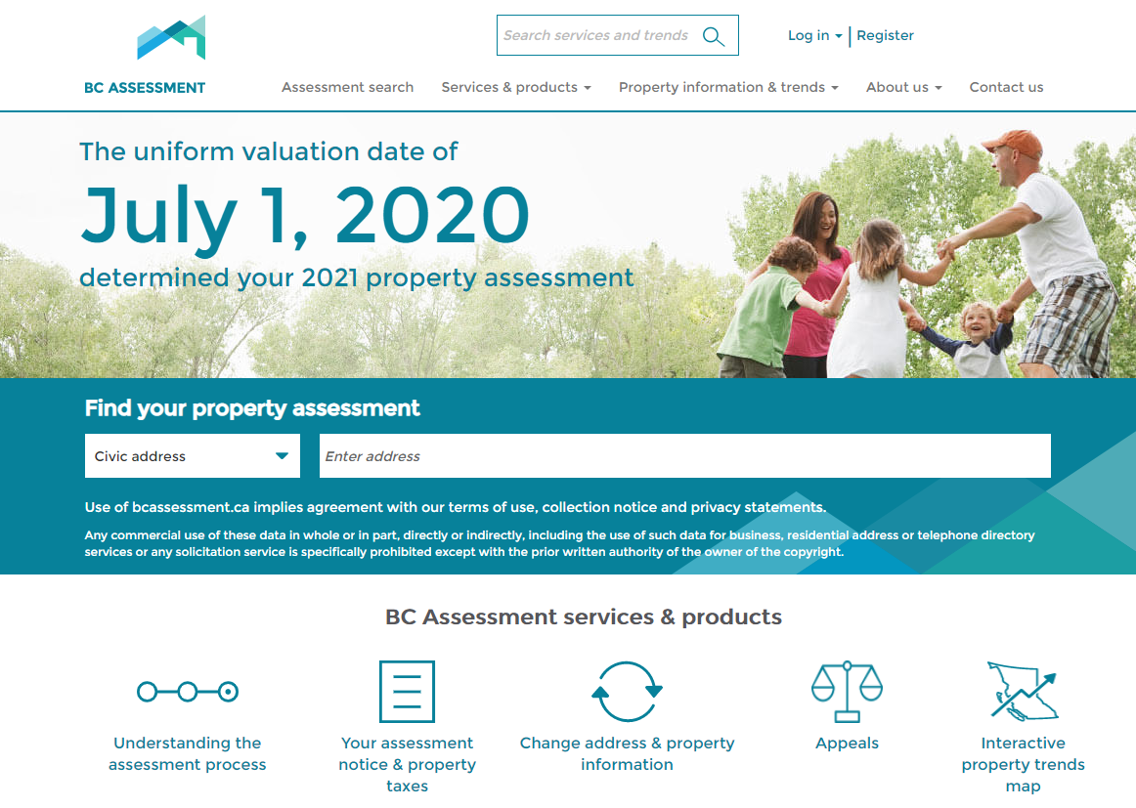
BC Assessment resources
www.bcassessment.ca
Assessment search tool
Property information & trends
Interactive property trends map
Information pages (FAQs)
BC Assessment YouTube channel
Data Advice
Assessment LinkBC
Standard Building Permit Report
Service Boundary Web Map
Call us:
1-866-valueBC (1-866-825-8322)

Slide 27

Questions?

